Slide 1

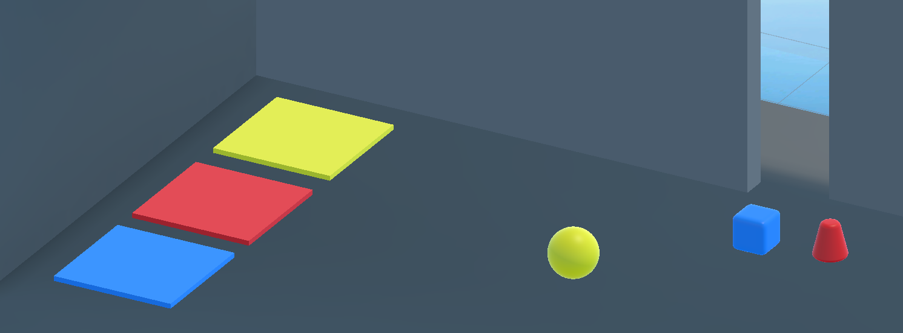
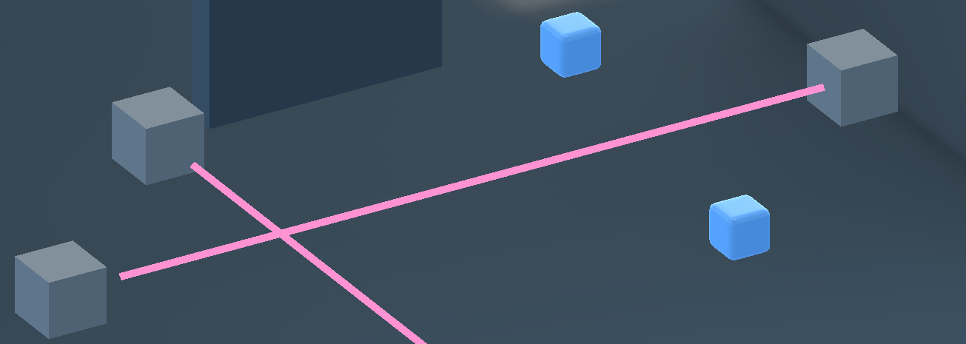
{
"taskUnits": [
{
"actionUnits": [
{
"type": "Grab",
"source_object_name": "Cube_salle2",
"source_object_fileID": 194480315,
"target_object_name": "collider_porte",
"target_object_fileID": 1631101808
},
{
"type": "Grab",
"source_object_name": "Pyramid_salle2",
"source_object_fileID": 863577851,
"target_object_name": "collider_porte",
"target_object_fileID": 1339877303
},
{
"type": "Grab",
"source_object_name": "Sphere_salle2",
"source_object_fileID": 284893529,
"target_object_name": "collider_porte",
"target_object_fileID": 1137377008
}
]
},
{
"actionUnits": [
{
"type": "Trigger",
"source_object_name": "Sender (1)",
"triggerring_time": 0.5,
"source_object_fileID": 807270095,
"triggerring_events": [
{
"methodCallUnits": [
{
"script_fileID": 829909757,
"method_name": "SetLaser",
}
]
}
]
}
]
}
]
}
Scene1: Place three objects onto their corresponding platform.
Task-1
Action-1
VRAgent
Action-2
Grab
Grab
Action-3
Grab
Task-2
Scene2: Trigger the laser sender.
Action-1
Laser Sender
Trigger
Method
Call-1
VRAgent

